Slide 1
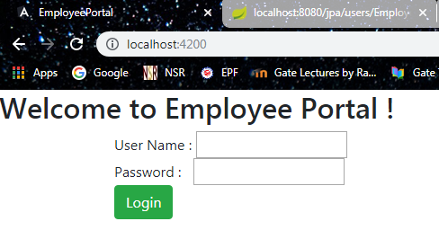
Employee Portal

Slide 2
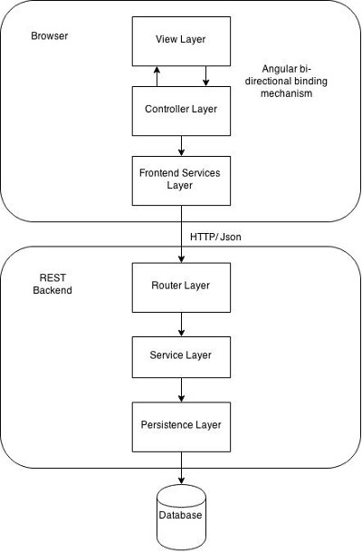
Architecture

Slide 3
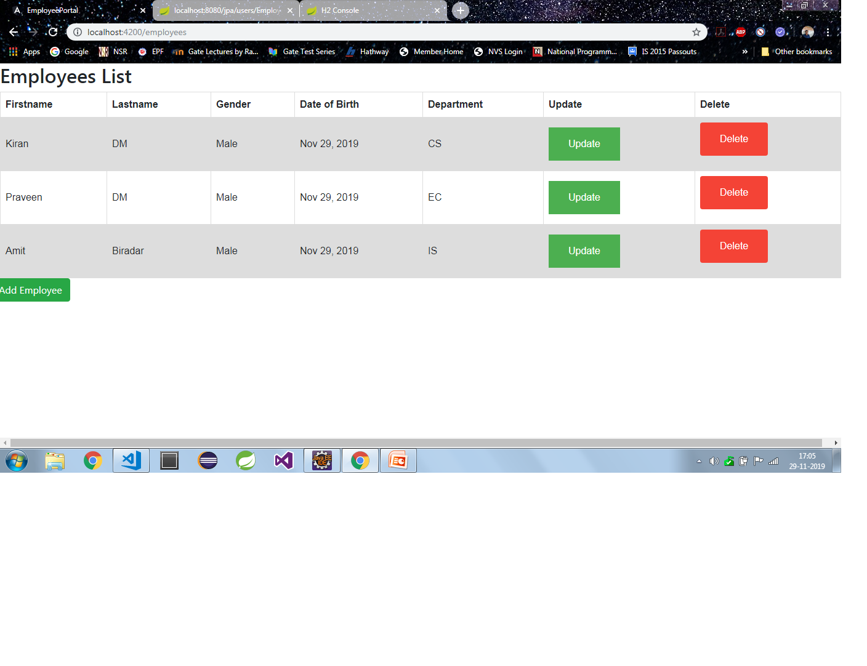
You will be navigated to Employees List Page

Slide 4
And then you can perform following actions
Add
Edit
Delete

Slide 5
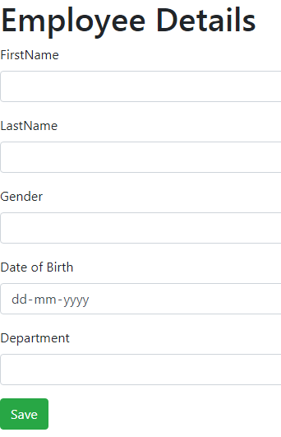
Add/Update Employee Page

Slide 6
Thank you ☺

